Slide 1
DOCKER NETWORKING USING OPENvSWITCH
Team:
Hasanth Sista
Karthik Reddy Vudagandla
Priyanka Gadde
Sushma Sunkollu Nagaraj
Venkatesh Gotimukul

Slide 2
AGENDA
* Introduction To Docker
* Docker Networking Using OpenvSwitch
* Opendaylight in Docker
* Wireshark in Docker
* Challenges faced
* Future Scope & Conclusion

Slide 3
Introduction to Docker
Why Docker?
What is a Docker?
What are the Docker Components?
In a nutshell!

Slide 4
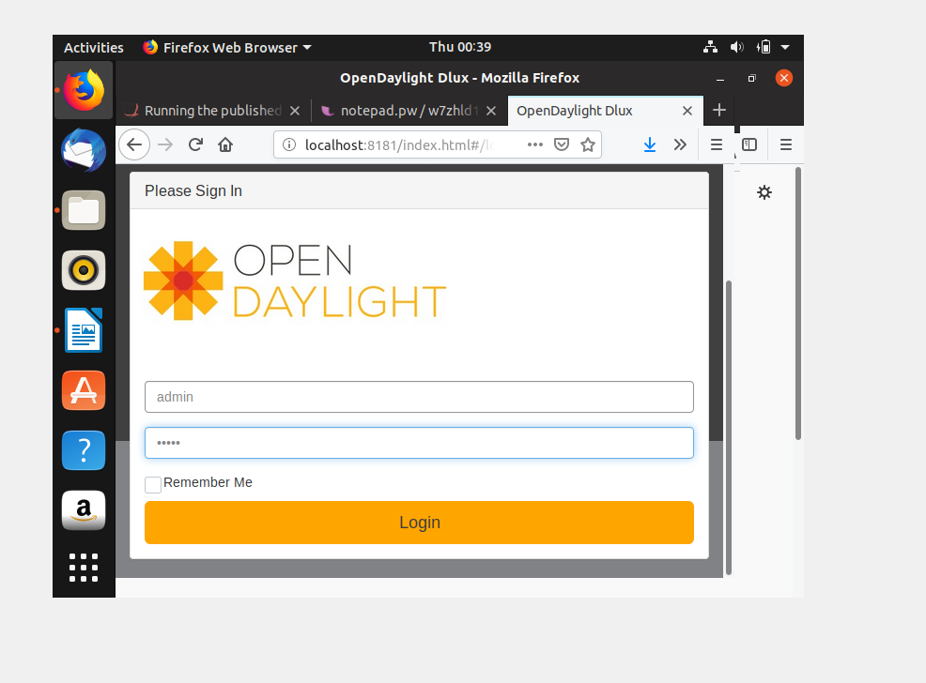
OpenDaylight:
OpenDaylight (ODL) is a modular open platform for customizing and automating networks of any size and scale. In this project, we are going to launch OpenDaylight from Docker.

Slide 5
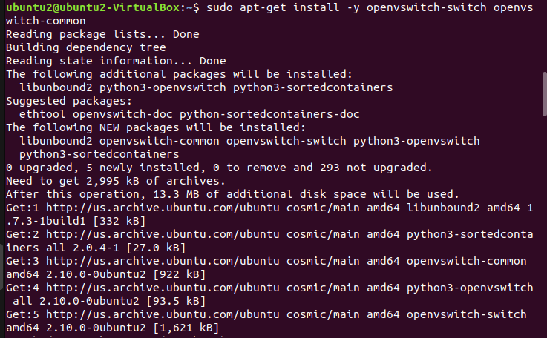
OpenvSwitch
Open vSwitch is an open-source implementation of a distributed virtual multilayer switch. In this project we are going to implement “Multi-Host Overlay Networking with Open vSwitch”.

Slide 6
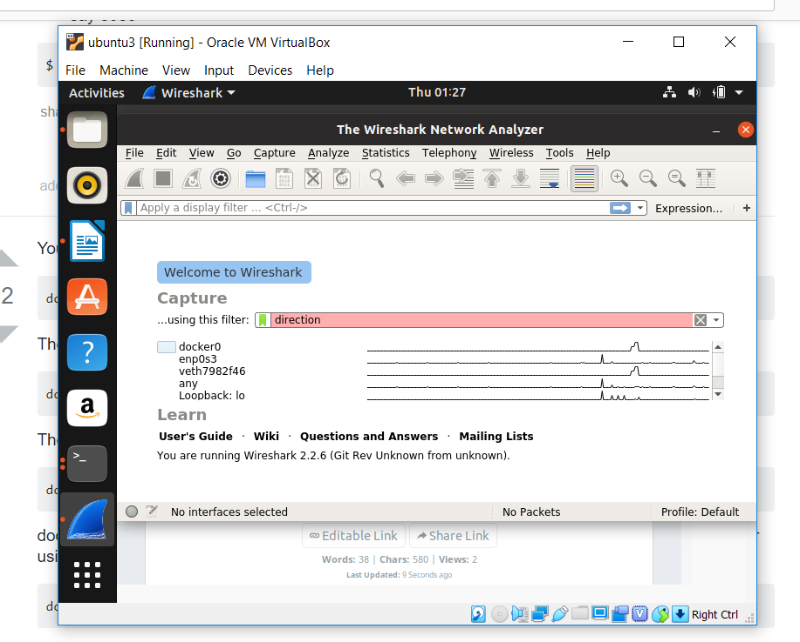
WireShark
Wireshark is a free and open-source packet analyzer. It is used for network troubleshooting, analysis, software and communications protocol development, and education. In this project we are launchung WireShark via docker for analyzing

Slide 7
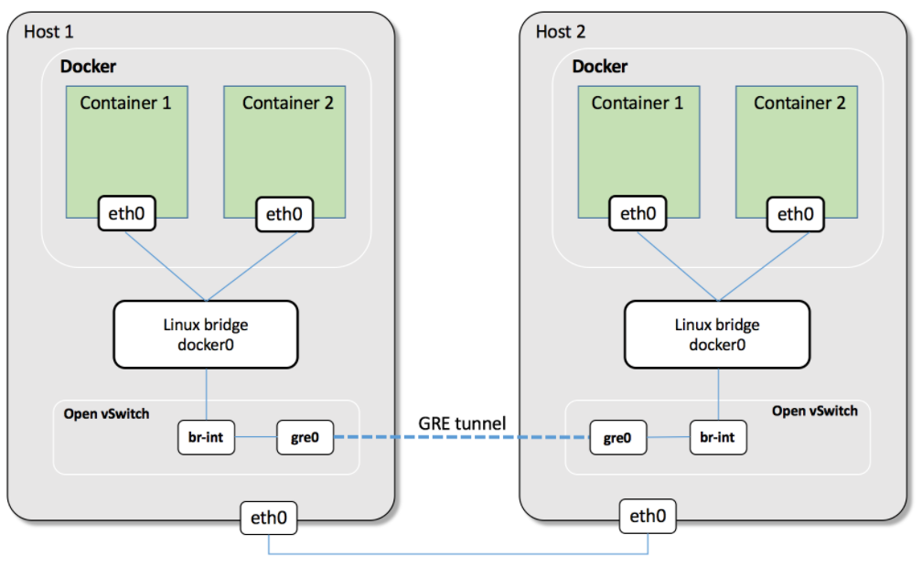
Docker Networking Using OpenvSwitch
ARCHITECTURE

Slide 8
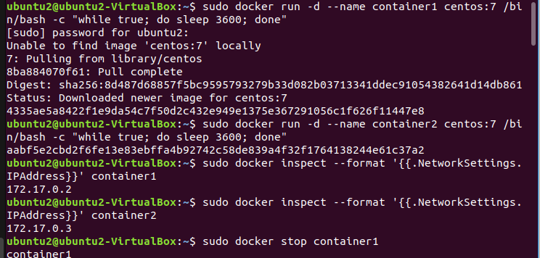
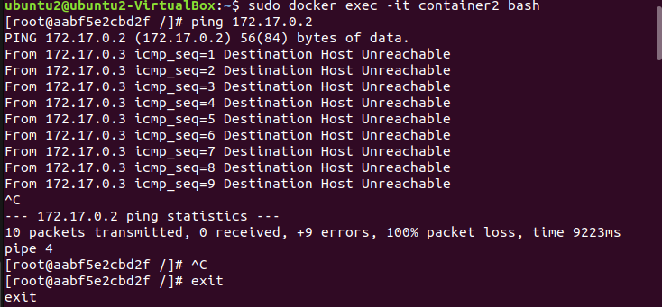
Output SCREENSHOTS
HOST-1

Slide 9
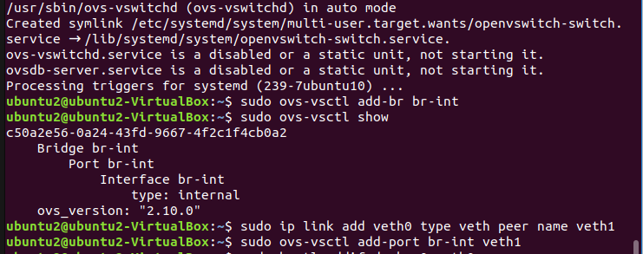

Slide 10
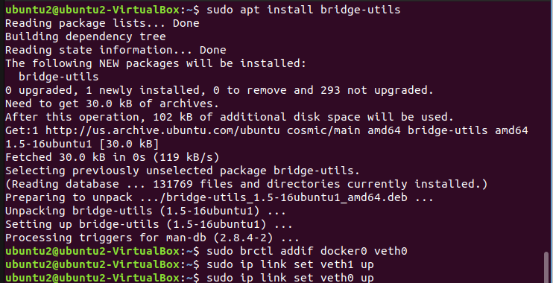
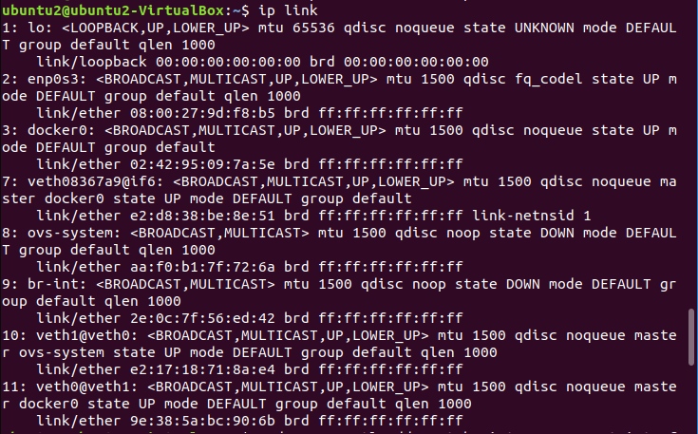
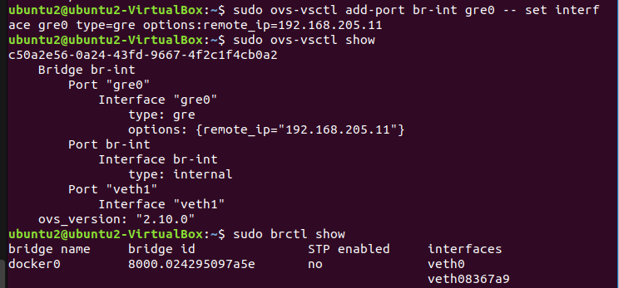

Slide 11
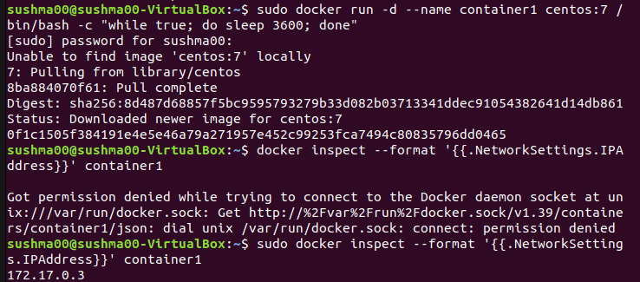
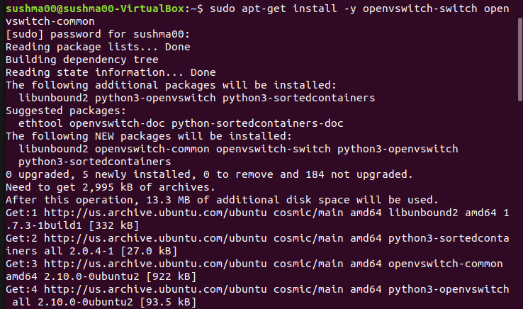
HOST-2

Slide 12
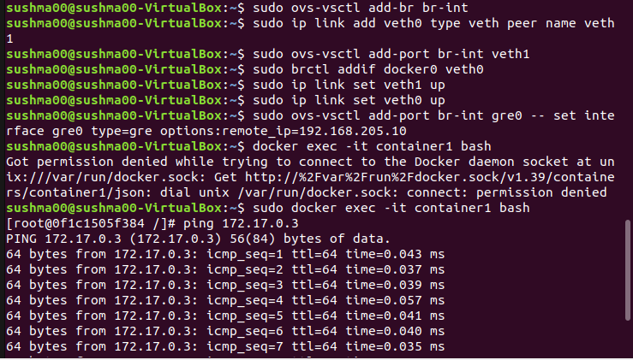
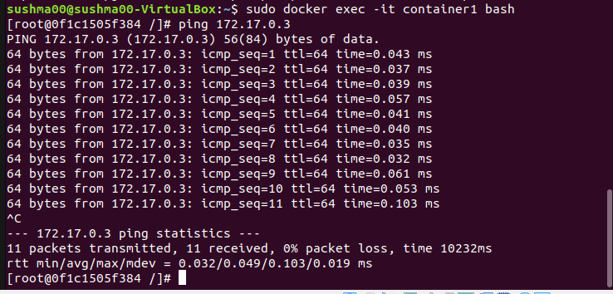

Slide 13
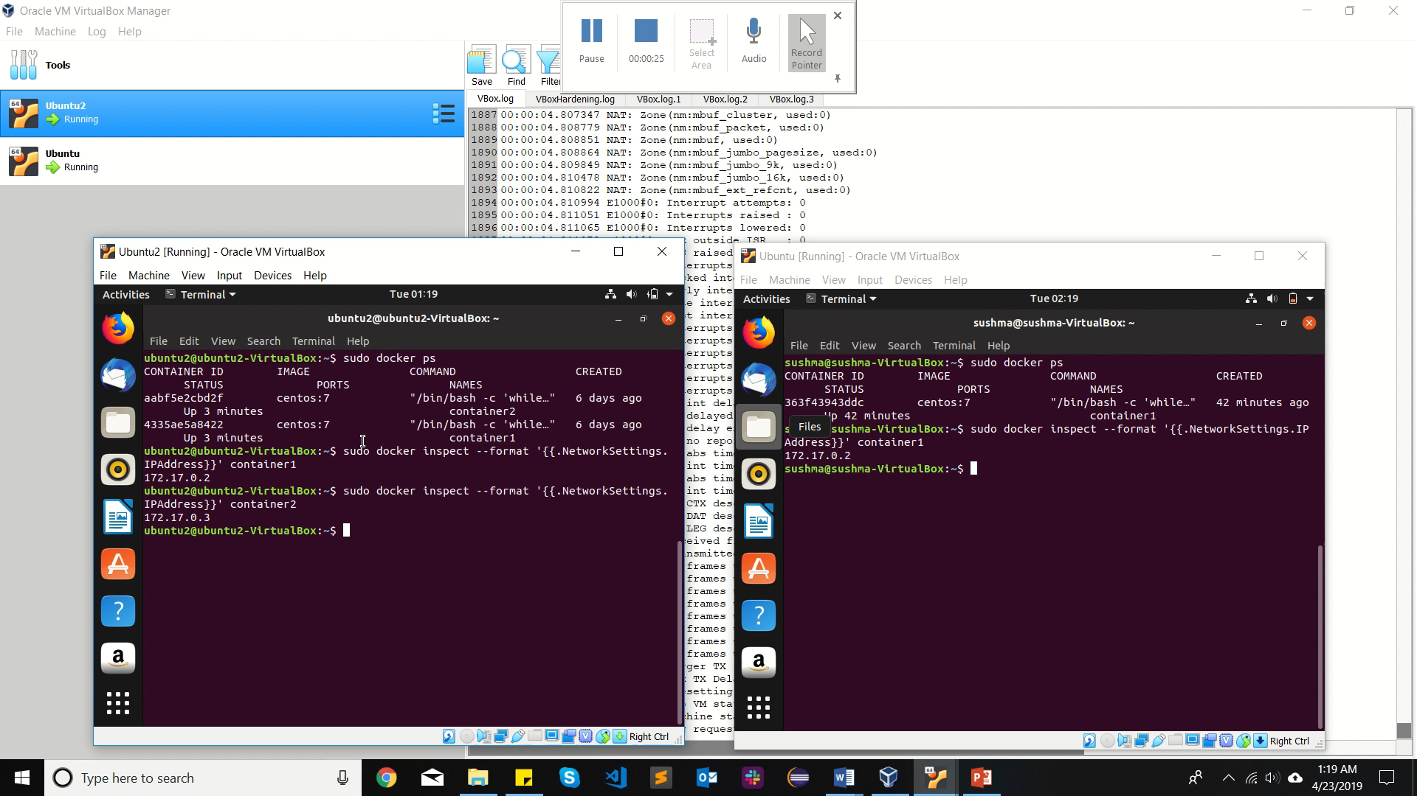
DEMO

Slide 14
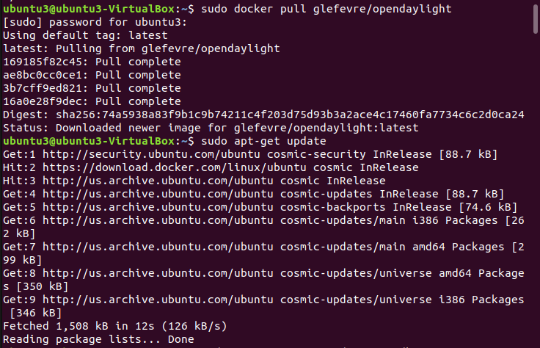
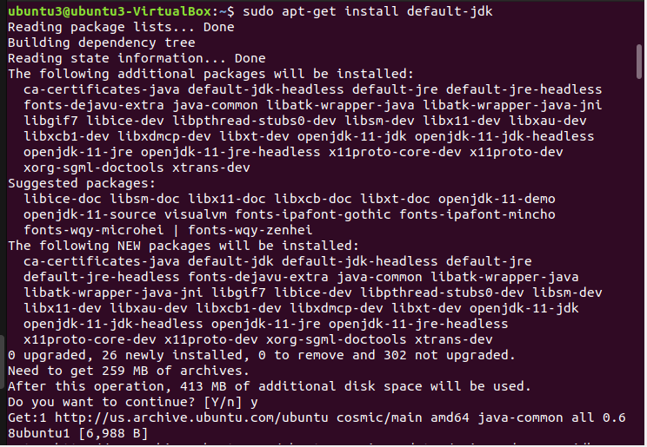
Opendaylight in Docker

Slide 15
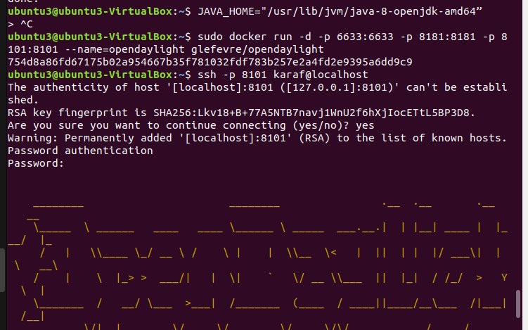
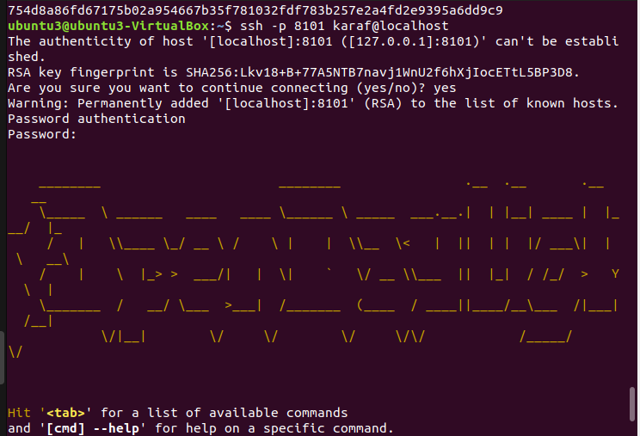

Slide 16
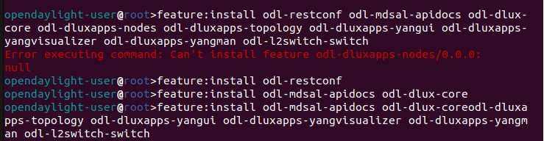
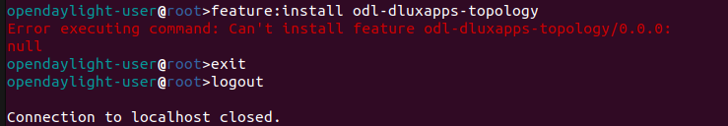

Slide 17
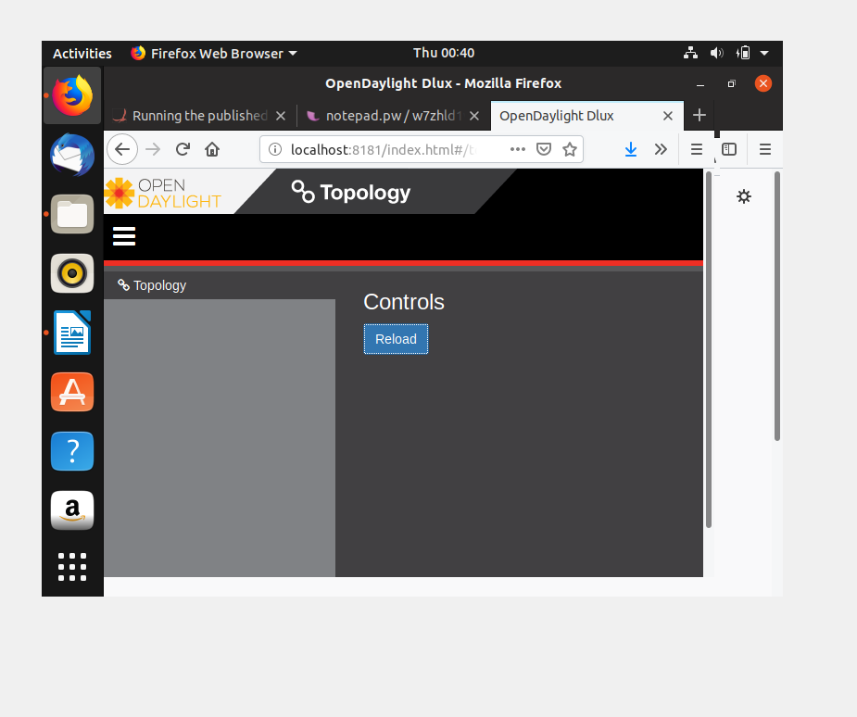

Slide 18
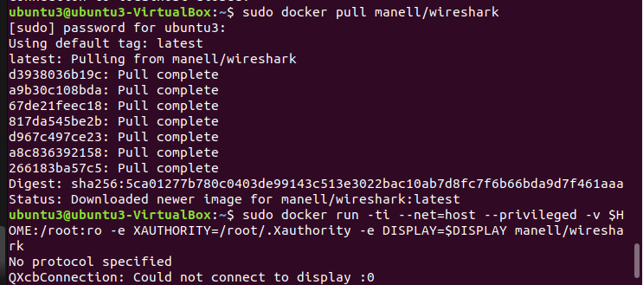
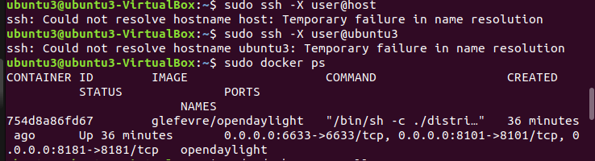
Wireshark in Docker

Slide 19
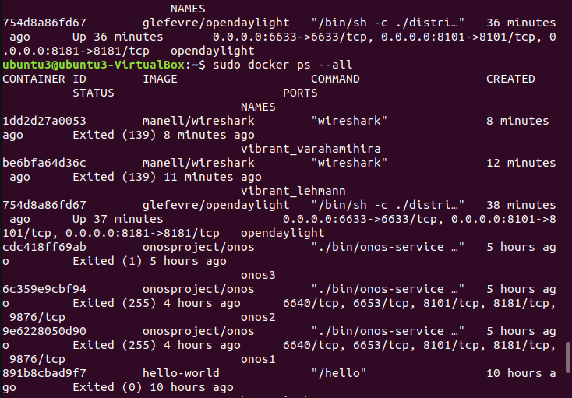
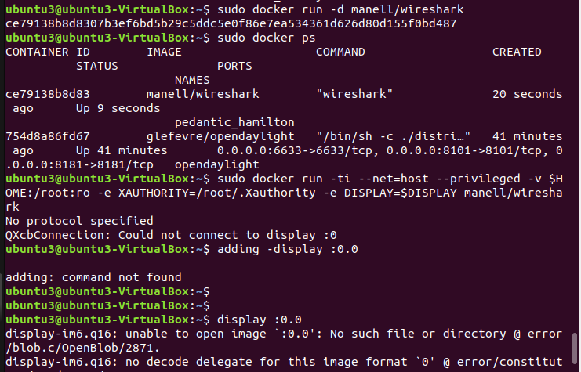

Slide 20
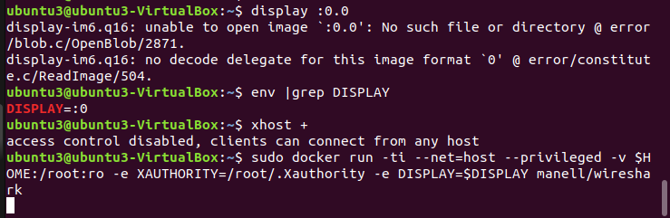

Slide 21
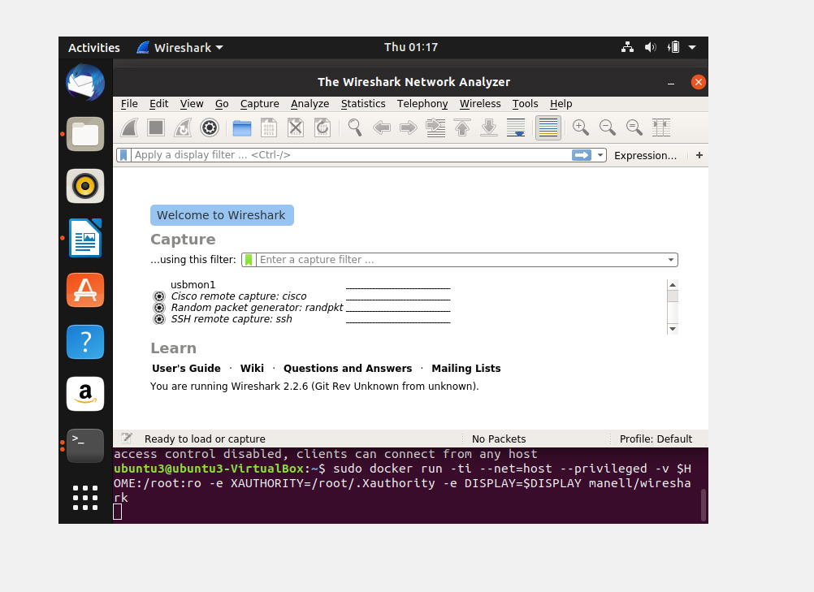

Slide 22
CHALLENGES FACED
Understanding networking in docker.
Installation of opendaylight on docker because of dependency issues.
Configuring tunnel connection between two hosts.

Slide 23
FUTURE SCOPE & CONCLUSION
Create a new docker network instead of using default docker0 bridge.
Configure cluster of opendaylight instances where each hosted on docker containers.
With the increase in the requirements for a project, dockers will be of paramount important.
In this project we tried to implement and launch SDN based controller, switches and analyzers using dockers.
Containerization using Dockers will be more useful in a practical team based environment.

Slide 24
THANK YOU !

